Slide 1
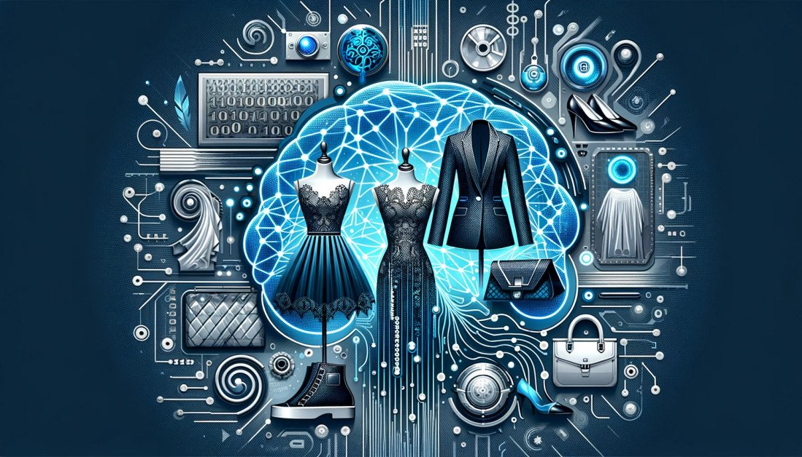
DEEPIKA.M
Final Project

Slide 2
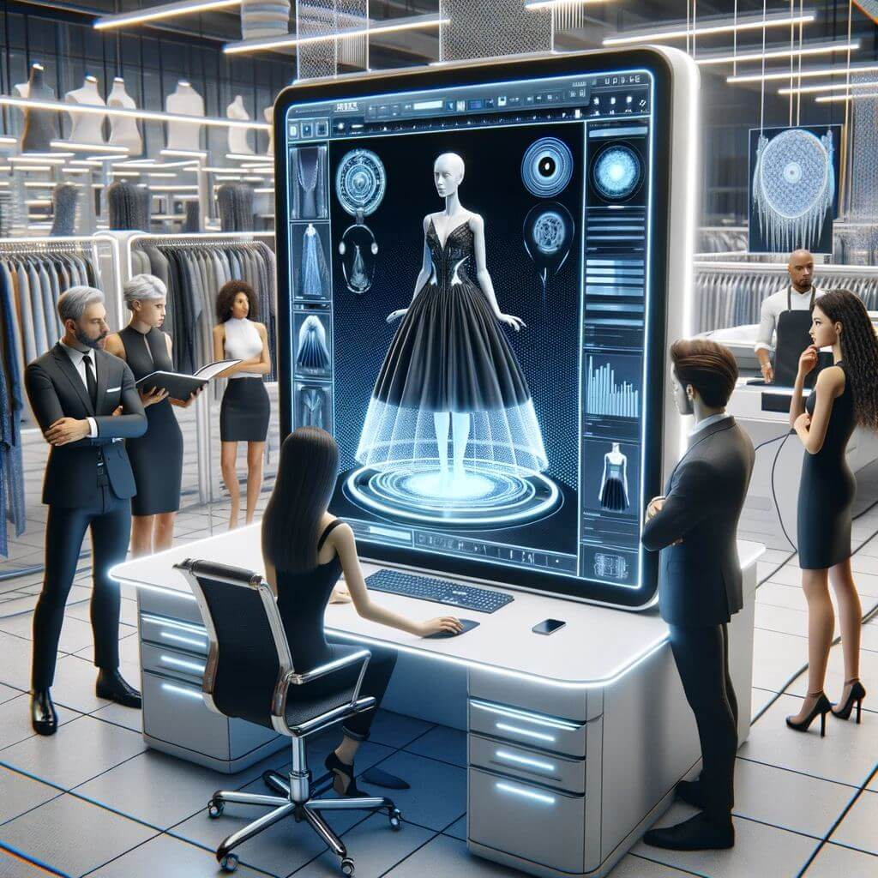
PROJECT TITLE
FashionFusion: AI-Driven Fashion Design Generation

Slide 3
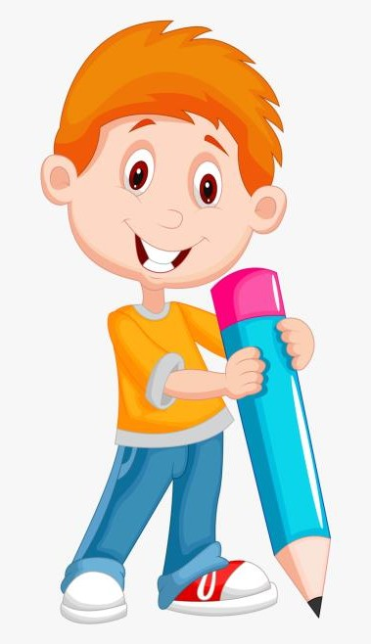

AGENDA
Introduction
Problem Statement
Project Overview
End Users
Solution and Value Proposition
The Wow in Your Solution
Modeling Approach
Results
3/21/2024 Annual Review

Slide 4
INTRODUCTION
FashionFusion introduces a groundbreaking approach to fashion design, harnessing the power of artificial intelligence (AI) to inspire and innovate. By meticulously analyzing vast datasets encompassing trends, styles, and consumer preferences, FashionFusion empowers designers with detailed insights into emerging fashion landscapes. Through its sophisticated algorithms, FashionFusion not only generates novel and trend-setting designs but also refines them to align seamlessly with contemporary tastes and market demands. This collaboration between human creativity and AI intelligence promises to revolutionize the fashion industry, offering designers unprecedented opportunities for experimentation, adaptation, and artistic expression.
3/21/2024 Annual Review

Slide 5

PROBLEM STATEMENT
Fashion designers face challenges in creating unique and innovative designs amidst rapidly changing trends and consumer preferences. There is a need for a solution that can leverage AI to assist designers in generating fresh and captivating fashion designs.

Slide 6
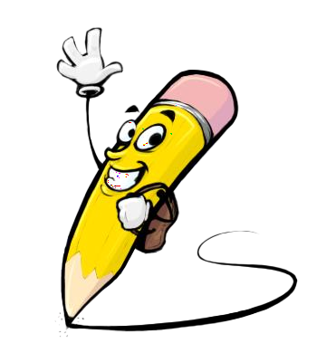
PROJECT OVERVIEW
Our project, FashionFusion, aims to revolutionize the fashion industry by harnessing the power of AI to generate novel and trend-setting fashion designs. By combining machine learning algorithms with creative design principles, we seek to inspire designers and redefine the boundaries of fashion innovation.

Slide 7

WHO ARE THE END USERS?
Fashion designers and stylists
Apparel manufacturers and retailers
Fashion enthusiasts and consumers

Slide 8

YOUR SOLUTION AND ITS VALUE PROPOSITION
FashionFusion offers an AI-driven platform that:
Generates diverse and original fashion designs based on input criteria and inspirations.
Accelerates the design process, providing designers with creative insights and inspiration.

Slide 9
YOUR SOLUTION AND ITS VALUE PROPOSITION
Enhances collaboration between designers and AI algorithms, fostering innovation and experimentation in fashion.

Slide 10

THE WOW IN YOUR SOLUTION
Seamlessly blend AI-generated designs with human creativity, resulting in truly unique and trend-setting fashion creations.
Provide personalized design recommendations based on individual preferences and style profiles.
Adapt and evolve with changing fashion trends, continuously inspiring and empowering designers to push the boundaries of creativity.
3/21/2024 Annual Review
10

Slide 11
MODELLING
Data collection: Gather a diverse dataset of fashion images, trends, and style inspirations.
Preprocessing: Extract features and patterns from fashion images using computer vision techniques.
Model selection: Explore and implement generative AI models like GANs (Generative Adversarial Networks) or VAEs (Variational Autoencoders) for fashion design generation.
Training: Train the model on the dataset to learn fashion aesthetics, styles, and trends.
Evaluation: Assess the quality and creativity of generated designs through expert reviews and user feedback.
11

Slide 12
RESULTS
Visual examples of AI-generated fashion designs.
Comparison with traditional design methods and existing AI-driven fashion tools.
User testimonials and feedback on the usability and effectiveness of the platform.
12

